Slide 1

Let’s Get Active North Carolina!!!

Slide 2
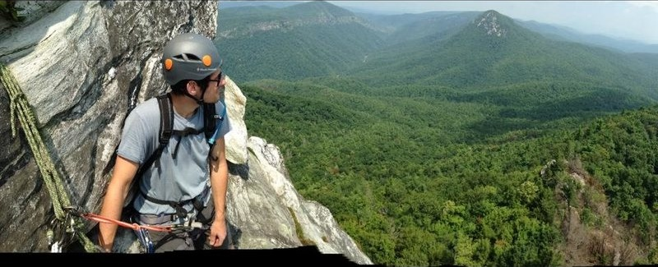
Rock Climbing in the Appalachians
Notes:
Rock-climbing: hands

Slide 3
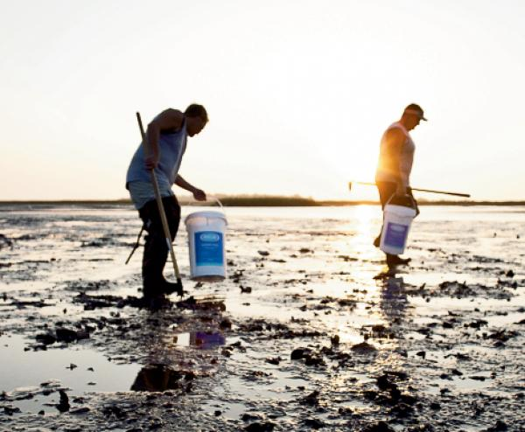
Digging for Clams on the Coast
Notes:
Digging: hands and feet

Slide 4
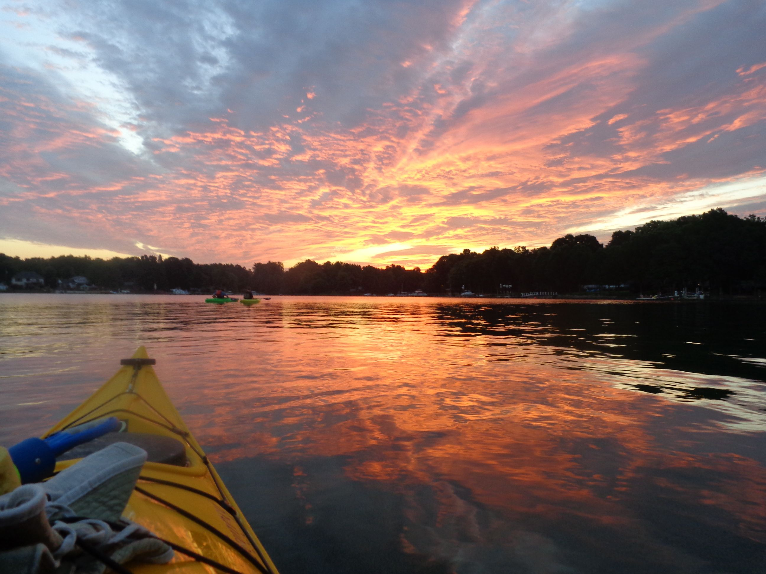
Kayaking on Lake Norman
Notes:
Kayaking: hands

Slide 5
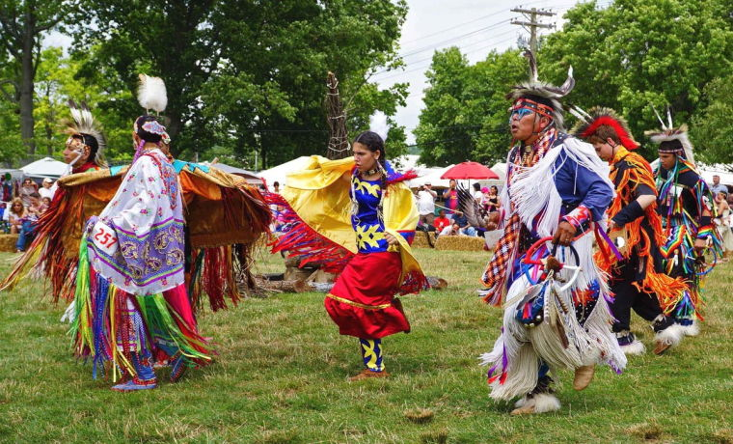
Cherokee Pow- wow Dance
Notes:
Powwow dance: hands and feet

Slide 6
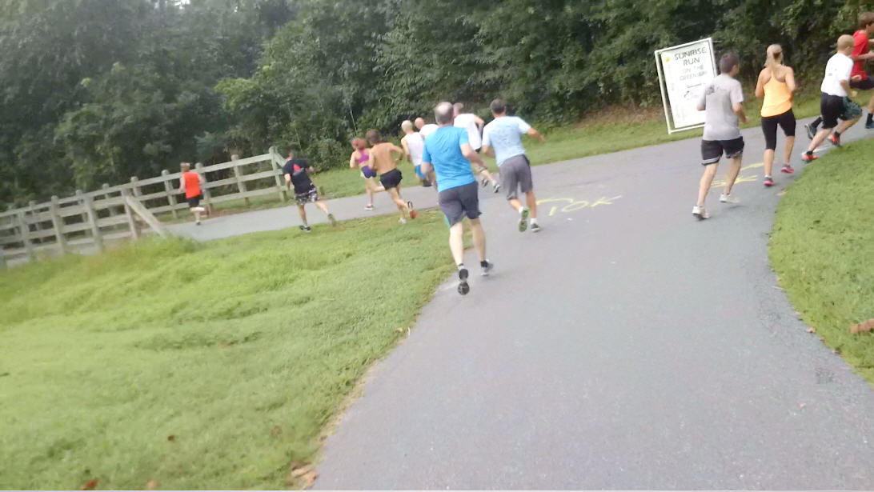
Running on the Greenway, Morganton
Notes:
Running (in place): feet

Slide 7
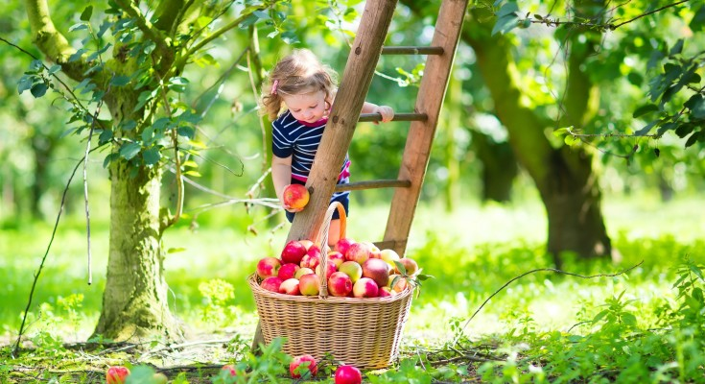
Apple Picking in Flat Rock
Notes:
Apple-picking: hands

Slide 8
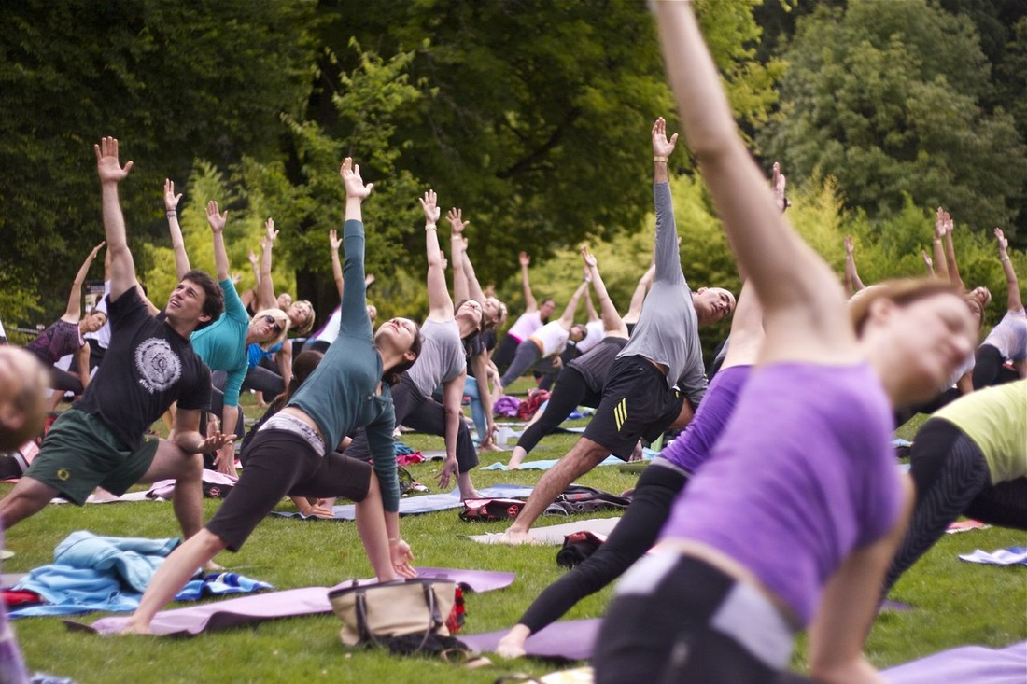
Yoga in the Park, Asheville
Notes:
Yoga: hands and/or feet?

Slide 9
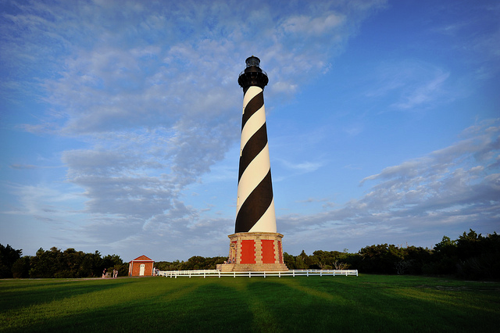
Climbing the Lighthouse, Cape Hatteras
Notes:
Climbing: feet

Slide 10
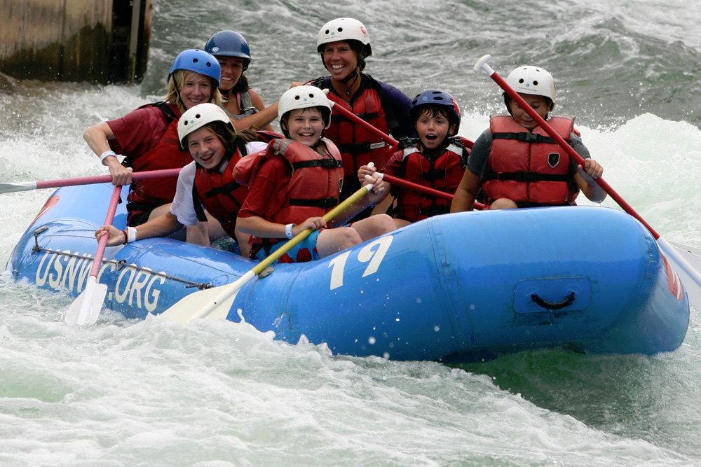
White-Water Rafting, Charlotte
Notes:
Rafting: hands

Slide 11
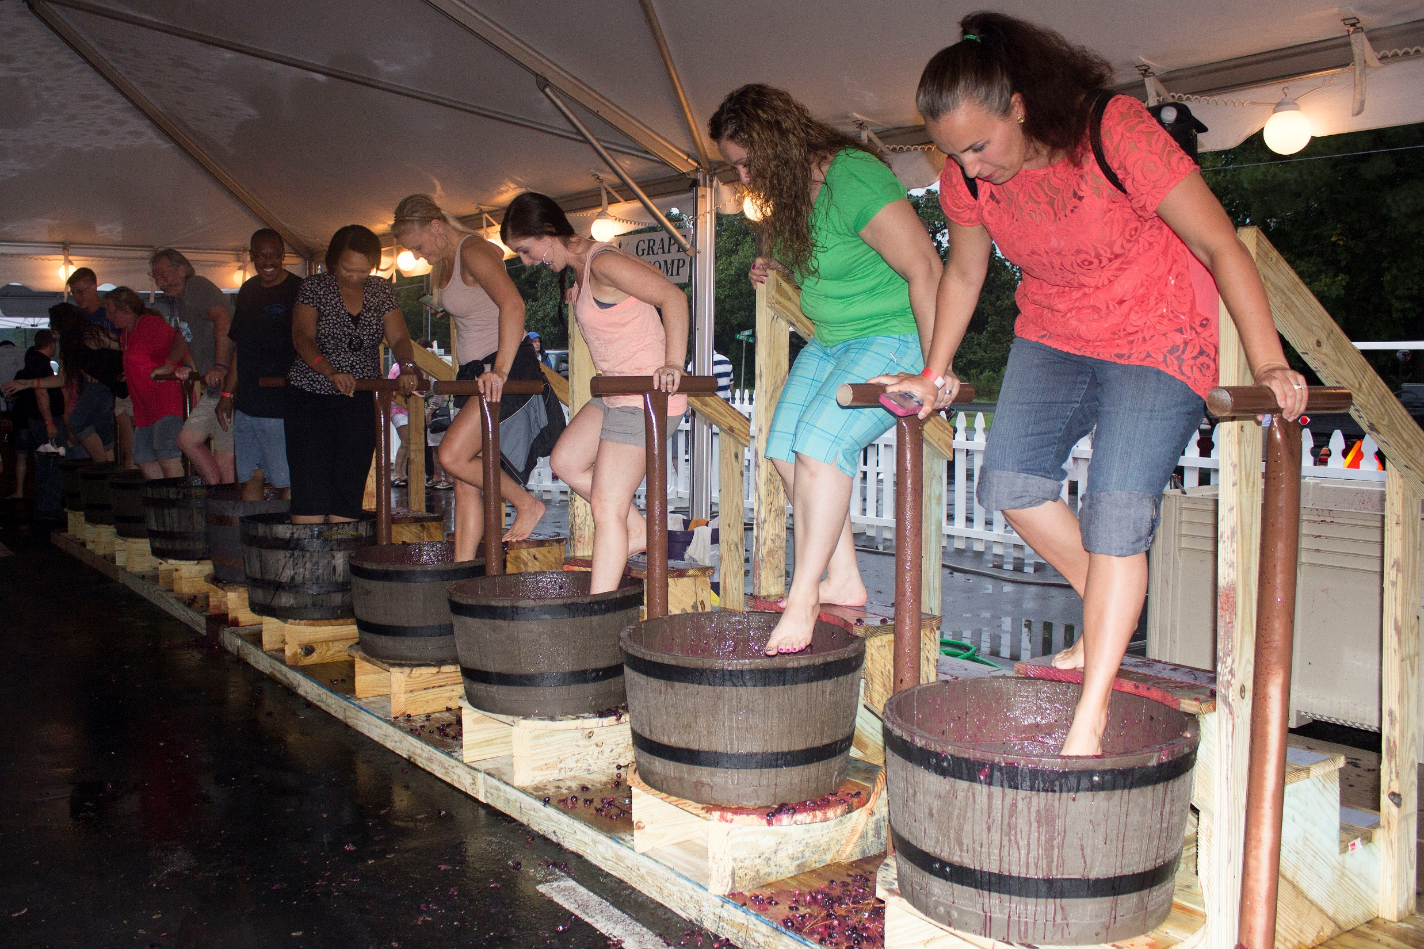
Wine Making at Duplin
Notes:
Wine-tasting: hands

Slide 12
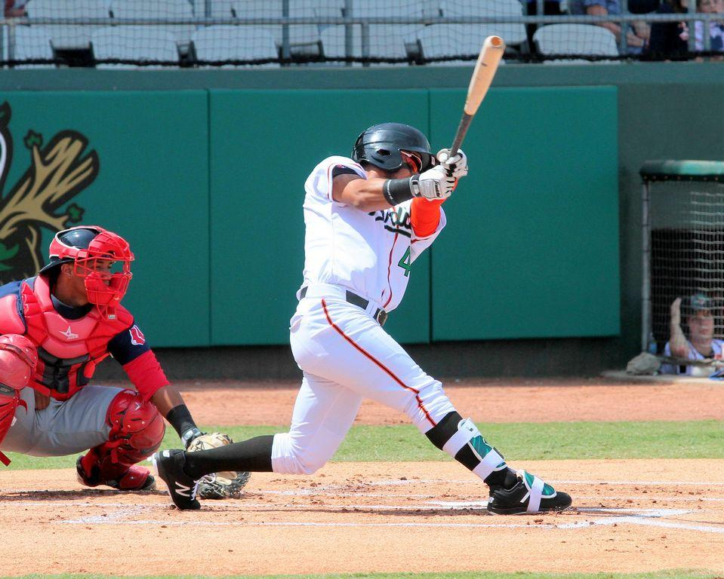
Swinging for the Fence with the Down East Wood Ducks
Notes:
Swinging: hands

Slide 13
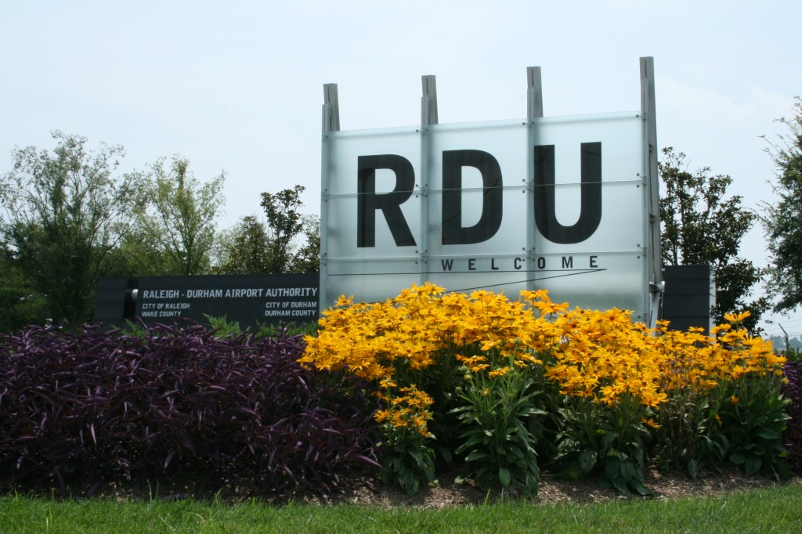
Flying Out of the Airport, Raleigh
Notes:
Flying: hands

Slide 14
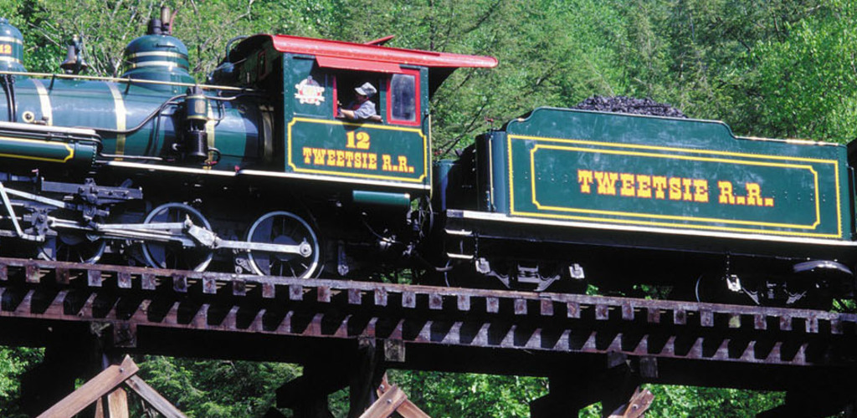
Blowing the Horn on the Tweetsie Railroad
Notes:
Blowing the horn: hands

Slide 15
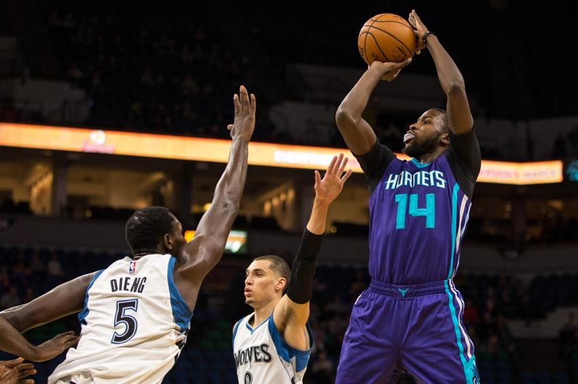
Shooting Hoops with the Hornets
Notes:
Shooting hoops: hands and feet

Slide 16
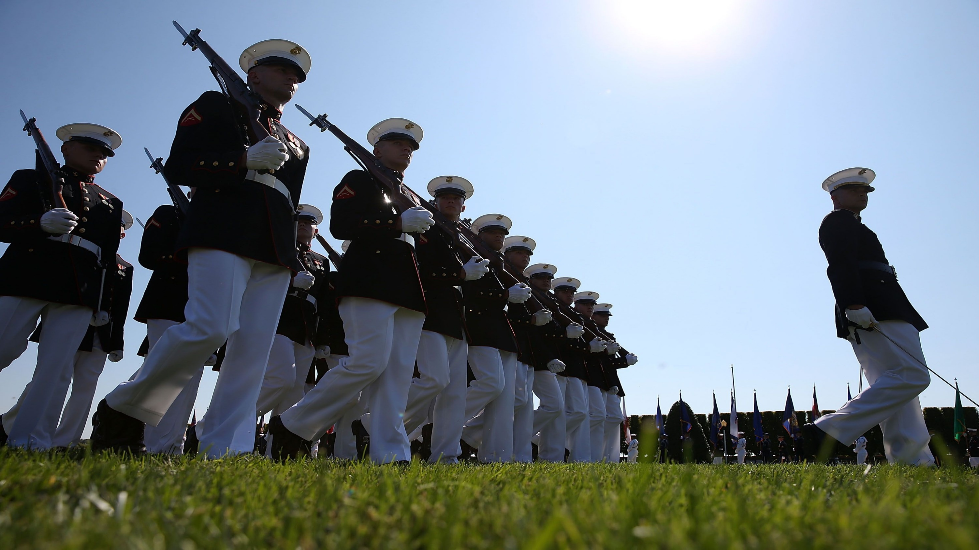
Marching with the Marines at Cherry Point
Notes:
Marching: feet

Slide 17
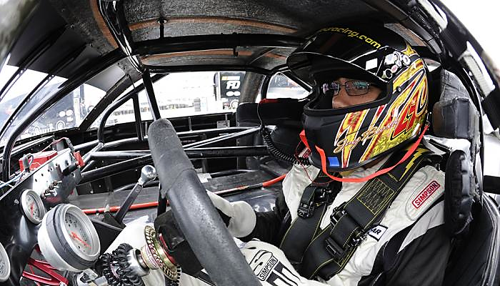
Rounding the Curves with NASCAR
Notes:
Driving: hands (and feet?)

Slide 18
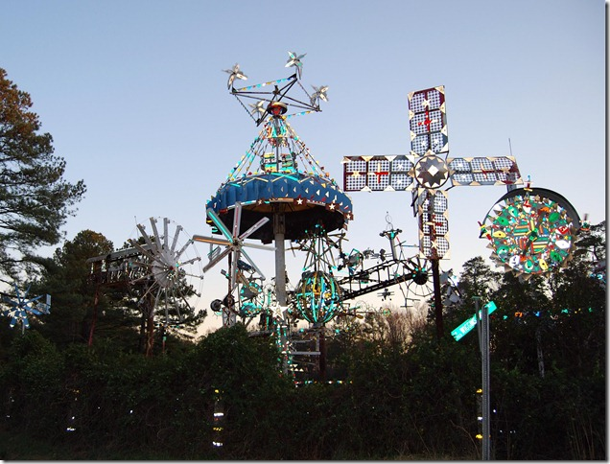
Whirling at Whirligig Park, Wilson
Notes:
Whirling: feet

Slide 19
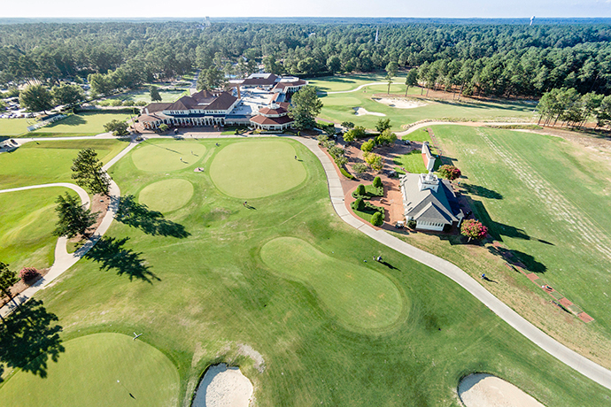
Golfing in the Sandhills, Pinehurst
Notes:
Golfing: hands

Slide 20
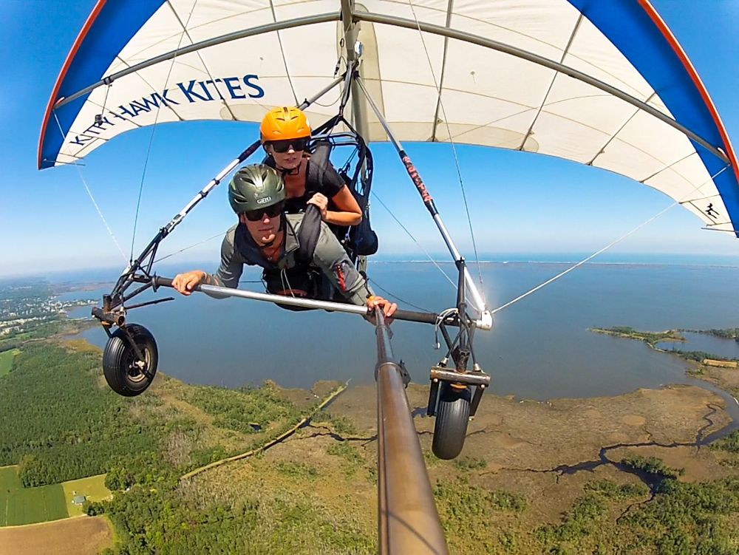
Hang Gliding at Kitty Hawk
Notes:
Hang gliding: ?

Slide 21
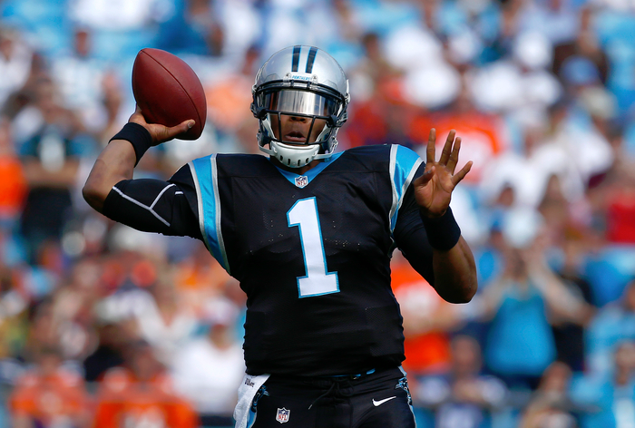
Throwing a Football with the Panthers
Notes:
Throwing a football: hands

Slide 22
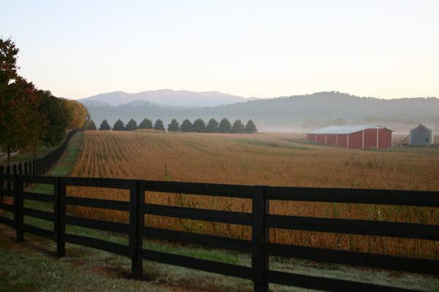
Farming in the Foothills, Lansing
Notes:
Farming (hoeing motion): hands/picking plants (with hands)

Slide 23
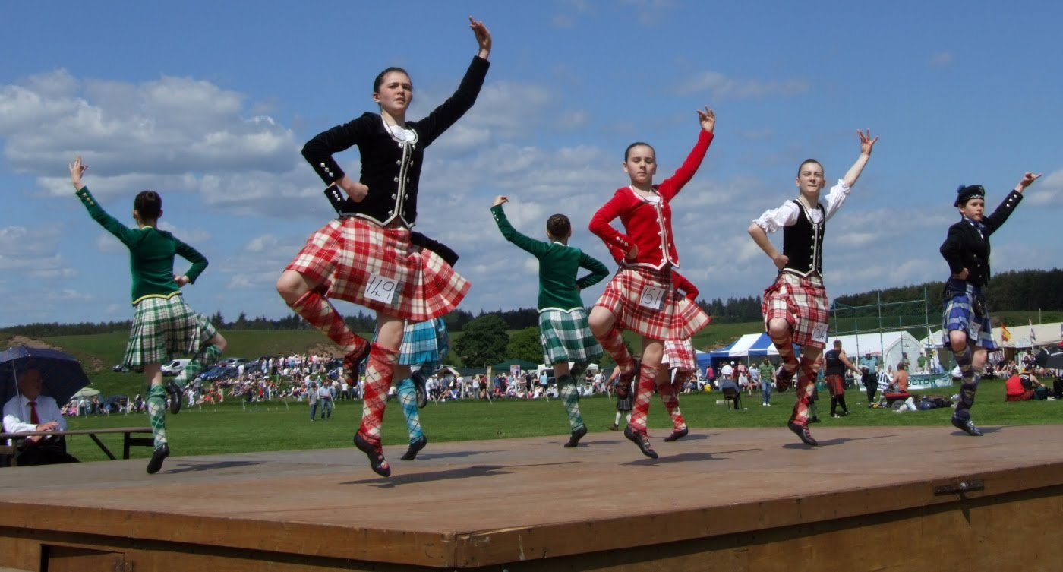
Highland Dancing, Grandfather Mt.
Notes:
Dancing: hands and feet

Slide 24
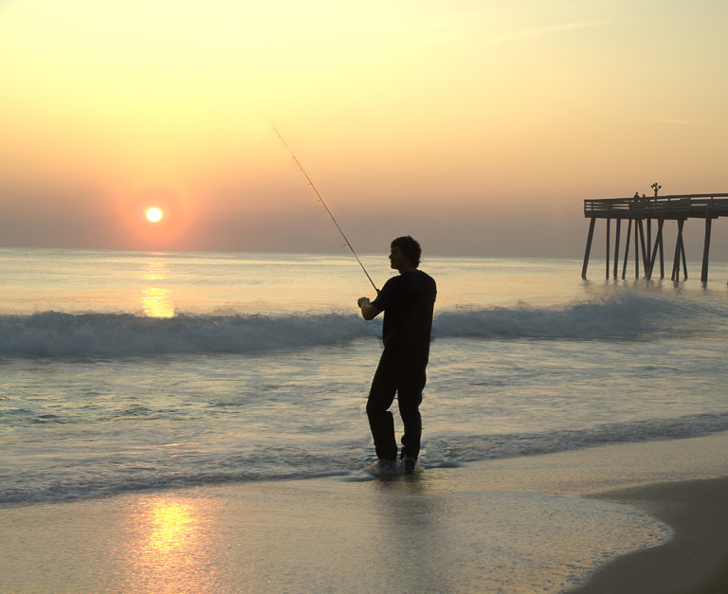
Fishing on the Outer Banks
Notes:
Fishing: hands

Slide 25



Thank You for Being Active with Us!
http://www.centralina.org/regional-planning/healthy-communities/
Sponsored by: http://plan4health.us/

