Slide 1


Slide 2

Mission Statement
We seek to educate and bring awareness to the public, local businesses and education centers of our region about stormwater issues and their impact on water quality and our environment. We further aim to unite local stormwater programs by sharing information and ideas in order to discuss and address similar stormwater issues on a regional level.

Slide 3
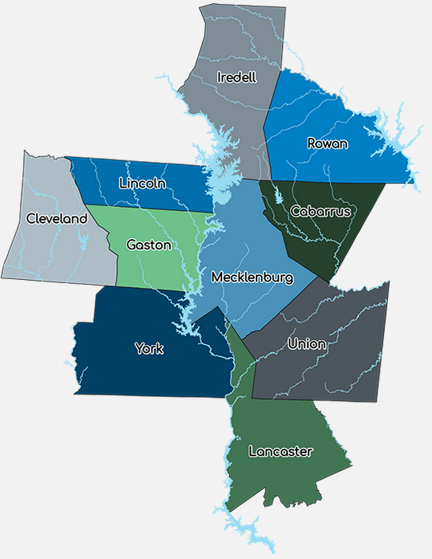
23 Municipal and County agencies
501c(3) Non-profit
Collaborates on Grant Opportunities
Promotes Stormwater Awareness through:
  Training & Workshops
  Website
  Radio & television ads
  Television interviews
  Outreach events

Slide 4
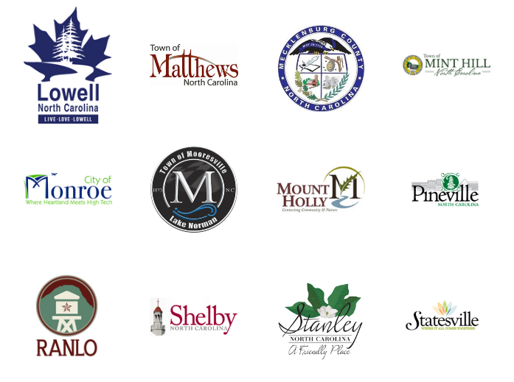
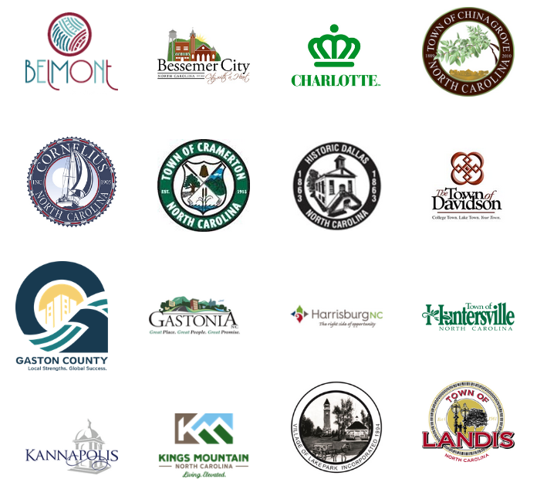
Our Partners

Slide 5
Training for municipal staff and elected officials.
Local elected officials' workshop.
Training videos for municipal staff.
Online tracking of staff training.

Slide 6
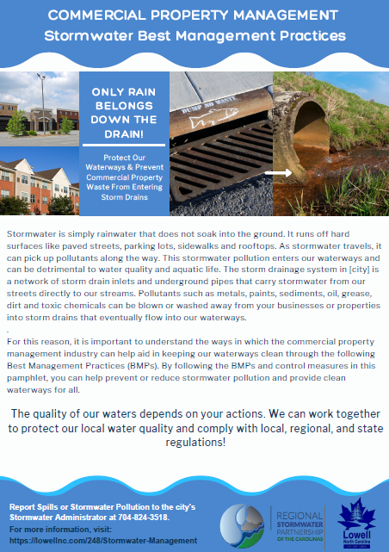
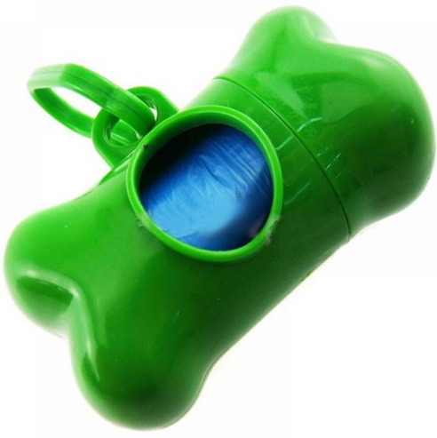
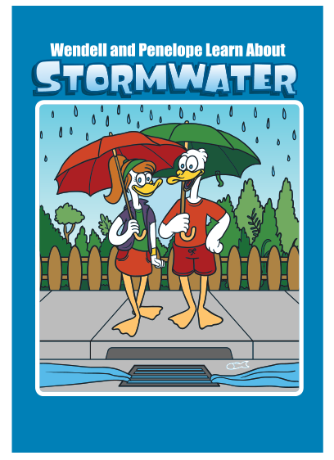
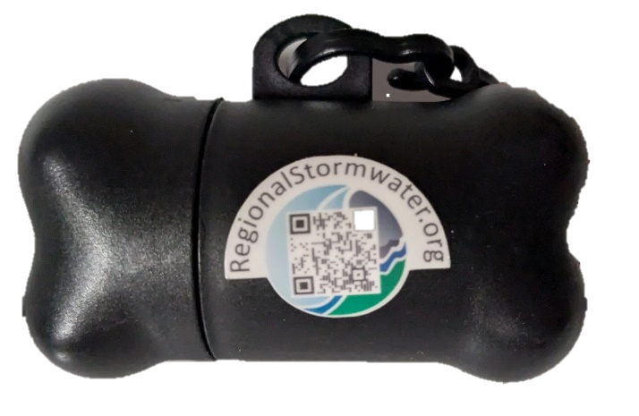
Marketing and outreach materials

Slide 7
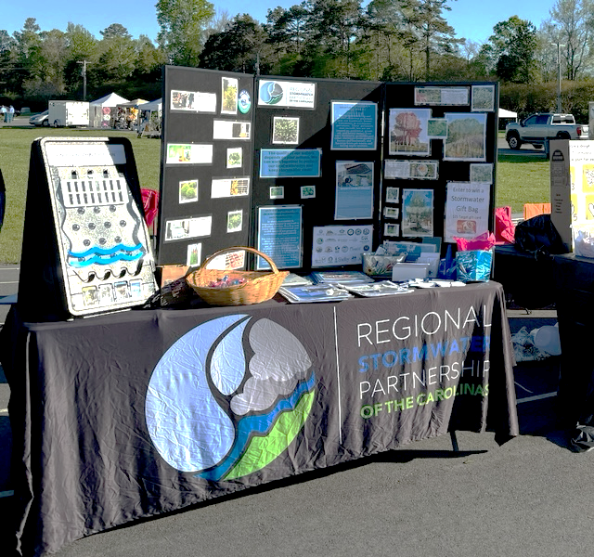
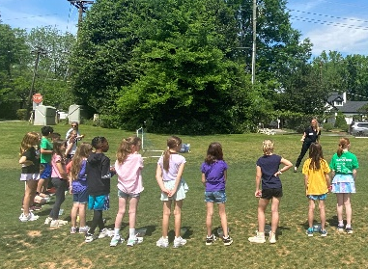
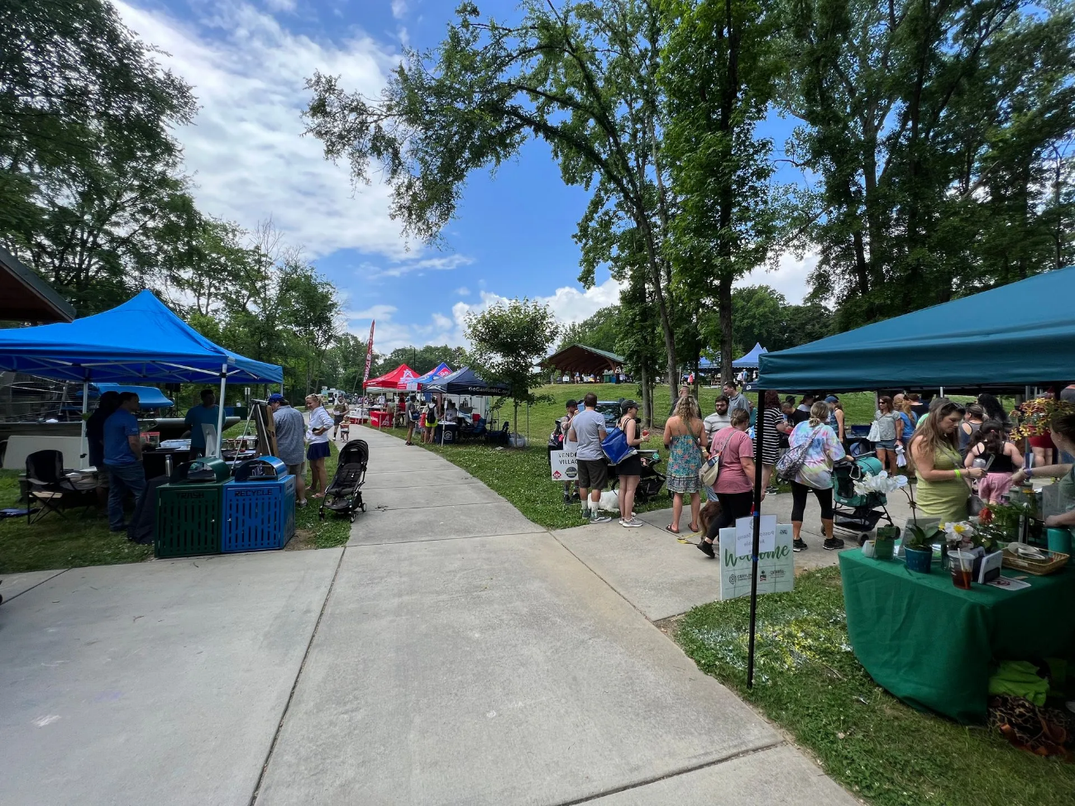
Assistance with outreach and educational events.
Vendor tent.
Outreach materials.
Games and prizes.
Collaboration with neighboring municipalities.
Networking.

Slide 8
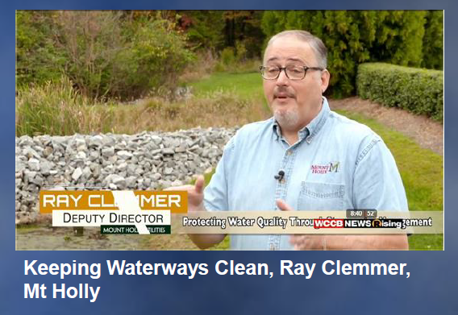
Coordinated media campaigns.
Radio advertisements.
Television advertisements and interviews.

Slide 9
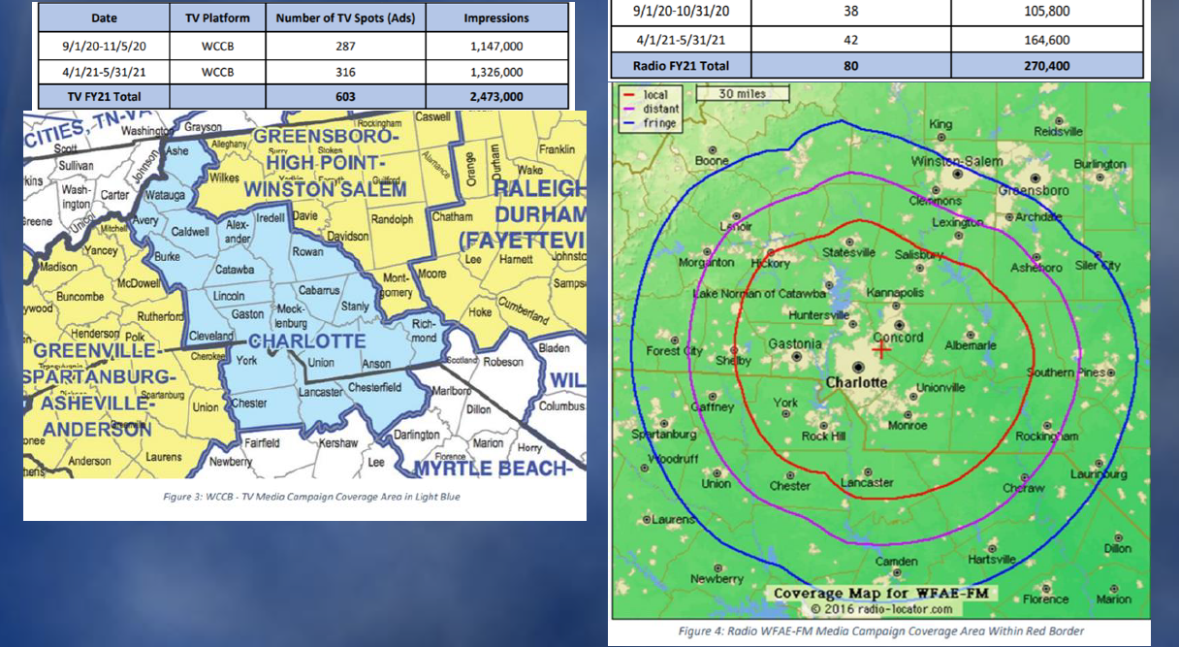
Reporting metrics for outreach efforts.
Event-specific outreach tracking.
Television and radio campaign reach.

Slide 10
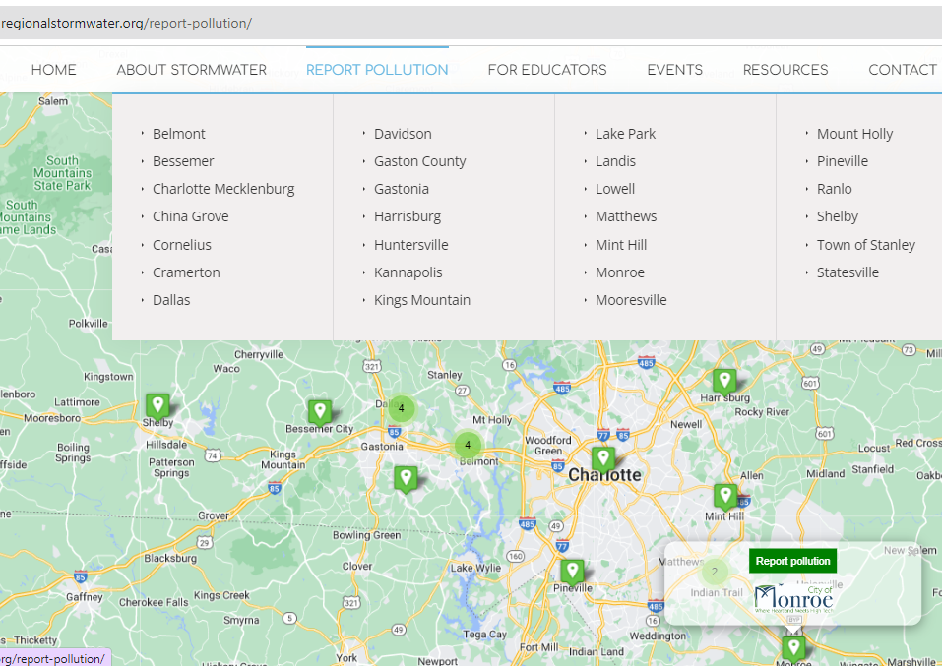
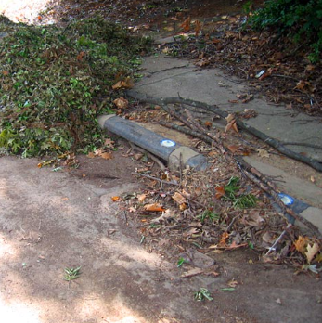
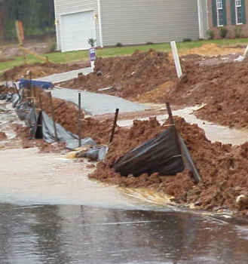
Pollution Education and Reporting

Slide 11
Kari Raburn, PhD
Facilitator for the Regional Stormwater Partnership of the Carolinas
VP of Chemistry and Engineering with Rising Solutions, PLLC kari.raburn@risingsolutionspllc.com
https://regionalstormwater.org/

Slide 12
Charlotte Water
Interbasin Transfer (IBT) Modification Request
Public Meetings, May 8, 9, 15 & June 25, 27 & July 15, 29, 2024
Submit questions & comments to: IBTProject@charlottenc.gov
Notes:
Ron Hargrove

Slide 13
Presentation Outline
About Charlotte Water
What is an IBT?
Why is an IBT modification needed now?
What is the IBT modification process and schedule?
What alternatives are being considered?
How can I comment and participate in the process?
Questions
Submit questions & comments to: IBTProject@charlottenc.gov
Notes:
Ron Hargrove

Slide 14
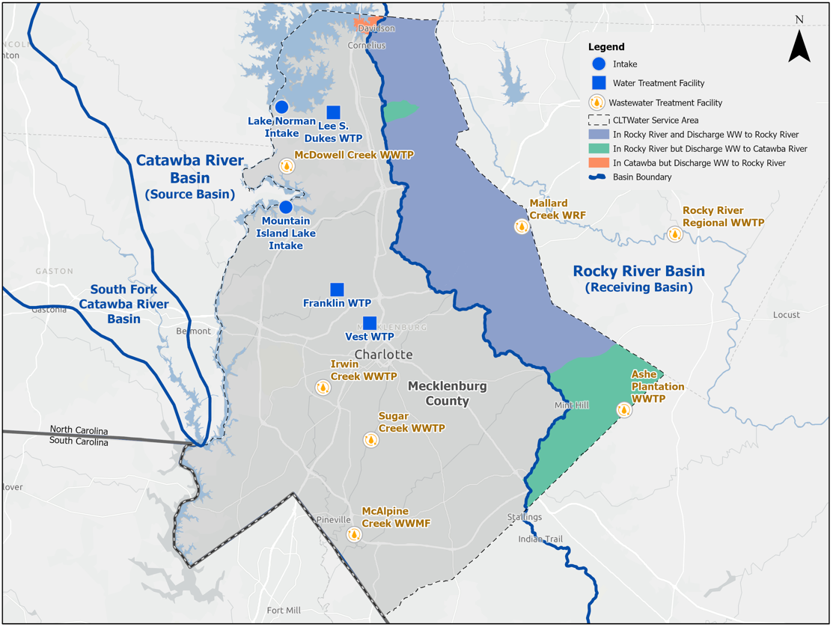
About Charlotte Water
Service Area includes Mecklenburg County and surrounding counties with customers in both Catawba & Rocky River Basins
Largest public water and wastewater utility in NC
Population Served – 1,145,392
Submit questions & comments to: IBTProject@charlottenc.gov
Notes:
Ron Hargrove
Discuss service area includes: 5 Towns, Charlotte, Meck County and service to surrounding counties

Slide 15
Proactive Planning
As projected, the original IBT supports Charlotte Water’s system through approximately 2028. Additional water through the modification process is timely.
2002 – Initial IBT of 33 MGD Peak Day
Now planning for next 30 years before the limit is exceeded
Long-term Partner with Catawba Wateree Water Management Group and Other Stakeholders
Local and Regional Conservation and Drought Planning
Submit questions & comments to: IBTProject@charlottenc.gov
Notes:
Ron Hargrove

Slide 16


What is an Interbasin Transfer (IBT)?
An IBT is a withdrawal, diversion or pumping of water from one source river basin to another river basin. The water from the source basin is treated and distributed to customers for everyday water usage, then collected and treated at wastewater treatment plants before portions are discharged to the receiving basin, resulting in the interbasin transfer.
Basin Boundary Line
Rocky River
Basin B
Consumption
5
Discharge
15
Withdrawal
116
Consumption
21
Catawba River
Basin A
Return
75
Transfer = Withdrawal – Return
The amount of a transfer is determined by the amount of water moved from the source basin to the receiving basin, less the amount of water returned to the source basin and consumptive use (i.e. irrigation) in the source basin.
Example
Withdrawal from A 116 MGD
Return to A - 75 MGD
Consumption A - 21 MGD
Transfer to B 20 MGD
Submit questions & comments to: IBTProject@charlottenc.gov
Notes:
Ron Hargrove
Reference back to State’s presentation
Based on 2022 IBT Water Balance

Slide 17
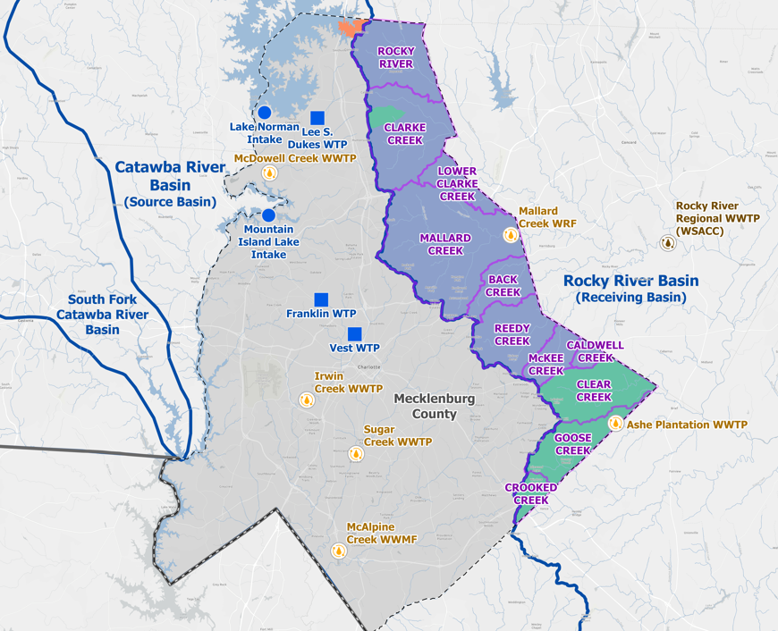
What is an IBT?
An IBT is a withdrawal, diversion or pumping of water from one source river basin to another river basin. The water from the source basin is treated and distributed to customers for everyday water usage, then collected and treated at wastewater treatment plants before portions are discharged to the receiving basin, resulting in the interbasin transfer.
Submit questions & comments online at: CharlotteWaterIBT.org
Notes:
Ron Hargrove

Slide 18
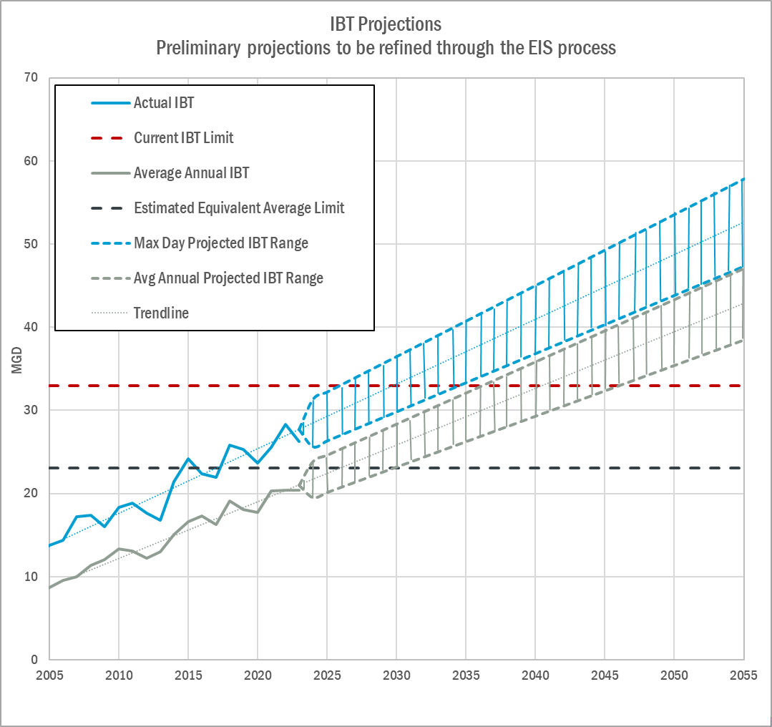
Why is an IBT Needed?
2002 IBT Certification limit is 33 MGD Peak Day
Currently at 79% of limit
Based on population projections, current IBT will be exceeded between 2028-2030 as previously planned
Submit questions & comments to: IBTProject@charlottenc.gov
Notes:
Ron Hargrove
Shown on graph: Max Day & Annual Avg, Actuals thru 2023 with 30-year projections

Slide 19
IBT Modification and EIS Development Process
Preliminary Activities
Notice of Intent and Notification of Public Meetings
Public Meetings & Comment Period (ends 8/30/24)
Today
Extended Stakeholder Engagement and Input
  Including SC Agencies & Stakeholders throughout the process
Incorporate and address public meetings comments
Alternatives Analysis
IBT studies – demand, conservation, drought, monitoring
NC DEQ Develops Draft Environmental Impact Statement (EIS)
EMC Public Hearing and determination of Adequacy of EIS
CLT Water Submits IBT Modification Request to NC DEQ
Prepare and Submit EIS in Coordination with DWR
IBT Modification Request and
EMC Process
EMC issues draft determination
EMC Public Hearing on draft determination
EMC Issues Final Determination on IBT
Submit questions & comments to: IBTProject@charlottenc.gov
Notes:
Ron Hargrove

Slide 20
IBT Modification Preliminary Schedule*
Fall 2024
to
Spring 2025
Spring 2024
Mid- 2026 (Estimated)
Late- 2026
(Estimated)
2027
(Estimated)
2027 (Estimated)
To Be Determined
IBT Notice of Intent & Public Meetings
Stakeholder Engagement Workshop(s)
Draft EIS to EMC
EMC Draft Determination of EIS Adequacy
Submit Draft IBT Modification to EMC
Final EMC Determination on IBT Modification
EMC Determination of Adequacy
Formal Public Comment Period and Focused Stakeholder Engagement Period
Alternatives Analysis and NC DEQ Develops Draft EIS
Public Hearing
on draft Determination
Public Hearings on draft Determination
*Coordination with SC DES Throughout
Acronyms:
EIS – Environmental Impact Statement
IBT – Interbasin Transfer
NC EMC – NC Environmental Management Commission
NC DEQ – NC Department of Environmental Quality
Submit questions & comments to: IBTProject@charlottenc.gov
Notes:
Ron Hargrove
Depending on EIS and review process and comments, could take longer

Slide 21
Preliminary Alternatives
Preliminary Alternative Categories Considered
  Pump wastewater back to the Catawba Basin
  Blending effluent with raw water at WTP (limited to 20%)
  Potable reuse from effluent (not currently allowed)
  New water sources in the Yadkin Basin
  Increase existing IBT through modification
Alternatives Evaluation Criteria
  Capital costs
  Schedule
  O&M costs
  Benefits/risks
  Environmental factors
  Construction feasibility
Actionable alternatives raised during scoping will be considered
Further refinement during EIS
Submit questions & comments to: IBTProject@charlottenc.gov
Notes:
Ron Hargrove

Slide 22
Public Meetings
For virtual Teams meeting information or to submit a comment/question, visit the Charlotte Water IBT website at:
CharlotteWaterIBT.org
Meeting #1 – Hickory, NC
    Wednesday, May 8, 5:30-7:00 pm
    Ridgeview Branch Library
    Z. Anne Hoyle Community Room
    706 1st St. SW, Hickory, NC 28602
Meeting #2 – Charlotte, NC
    Thursday, May 9, 6:00-7:30 pm
    Charlotte Water
    4100 W. Tyvola Rd, Charlotte, NC 28208
Meeting #3 – Albemarle, NC
    Wednesday, May 15, 5:30-7:00 pm
    EE Waddell Community Center
    Banquet Room
    621 Wall St., Albemarle, NC 28001
Meeting #4 – Camden, SC
    Tuesday, June 25, 6:00- 8:00pm
    Revolutionary War Visitor Center
    Liberty Hall
    212 Broad St., Camden, SC 29020
Meeting #5 – Florence, SC
  Thursday, June 27, 6:00- 8:00pm
  Francis Marion University
  Chapman Auditorium
  4800 E. Heyward Dr., Florence, SC 29506
Meeting #6 – Morganton, NC
    Monday, July 15, 6:00- 8:00pm
  CoMMA Performing Arts Center
  401 S. College St., Morganton, NC 28655
Meeting #7 – Rock Hill, SC
    Monday, July 29, 6:00- 8:00pm
  Dutchman Creek Middle School
  4757 Mt. Gallant Rd., Rock Hill, SC 29732
Submit questions & comments to: IBTProject@charlottenc.gov
Notes:
Angela Charles
Note the South Carolina meetings are being rescheduled

Slide 23
Stakeholder Engagement
Workshops
Goal: Identify actionable alternatives to increasing IBT that should be evaluated within the scope of the EIS
Looking for stakeholders to represent broad and diverse interests
Stakeholders will have the ability to shape the alternatives that will be considered
Logistics:
  Fall 2024
  Professional facilitation – CDMSmith selected
  Multiple workshops – At least 3
  Meeting format – in-person with virtual option

Slide 24

















Draft Stakeholder Interests
Industry/Economic Development
Water Planning Electric Power Recreation Environment
Regulatory
Catawba/Yadkin
Riverkeeper
Environmental Advocacy Groups
CWWMG
YPDWMG
DMAG
NC/SC Wildlife Resources
US Fish/Wildlife
NCDWR
and SCDES
Duke Energy
REBIC/Developer interests
Pee Dee and Santee River Basin Councils (SC)
Other Economic Development Groups
Charlotte Regional Business Alliance
Marine Commissions
Nature Conservancy and other Conservation Groups
Other Power Companies
LUESA
and like agencies in SC
Local Government
Other Groups
Local & State
Elected officials
Agriculture (Farm Bureau) Forestry
Other NGOs
At-large Interests
Lakefront HOAs
Water and Wastewater Utilities
Towns, Cities and Counties
Staff
Council of Governments
Soil & Water Conservation Districts
Catawba Nation
Version: 7-29-24

Slide 25
Example Workshops Structure
Workshop #1
Brainstorm risks and opportunities
Workshop #2
Develop framework to identify and evaluate alternatives and mitigation strategies
Workshop #3
Consensus building on principle risks ways to address risk
Pre-Workshop Interviews:
Understand specific concerns, dispel misinformation
Interest Group Round-Tables
Subsets of stakeholders to gage satisfaction

Slide 26
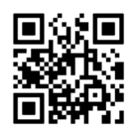
Questions or Comments?
David Czerr- Charlotte Water
david.czerr@charlottenc.gov
Submit questions & comments to: IBTProject@charlottenc.gov
Notes:
Angela Charles
All CLTWater team at front table
Request ~3 minute time for questions/comments, be respectful of others’ time, have to be out by 8pm
We will receive questions and/or clarify mis-statements but specific answers provided as part of the EIS; if simple response/answer-update FAQs on website
All questions/comments are recorded/logged and considered equally including those submitted via Teams Chat

